Slide 1
Iconic Saga
March 2024

Slide 2

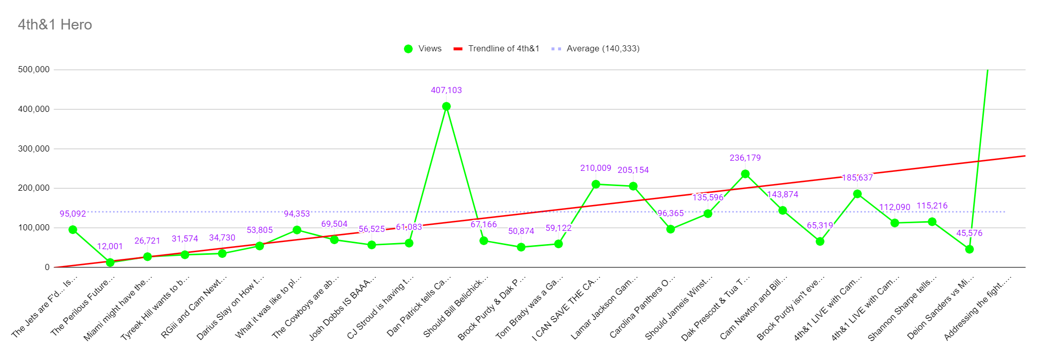
Growth Rate:
7.76% per video

Slide 3

Hero & Clips
Learnings
Total Hero Views: 3,648,649
Total Clip Views: 6,651,690
Subscriptions (Hero) driven: 36,097 - 0.98%
Subscriptions (Clips) driven: 54,970 - 0.82%
Average (Hero) CTR: 5.5%
Average (Clip) CTR: 7.3%
AVD (Hero): 18.5%
AVD (Clip): 39.9%
Generated nearly the same amount of money
We can generate a lot of $ from clips.
We need to raise subscriptions driven
We need to NAIL thumbnail faces
Focus on those intros
GAME... How much are they off by?
$0.83

Slide 4
4th Format
-Embrace strong intro leading to long form format AVD
-Enable vertical bois with more content growth
-Ask for subscribe ASAP growth
1:00:00
1:00
:30-1
:5-:30
5-10
5-10
2-3
5-10
20:00
15:00?
1:00
Pre-Intro
Cam opening
Iconic Members
1st
2nd
3rd
4th
Newton’s Law
Something?
Outro

Slide 5

Pre-Intro
Learnings
AVD (Hero): 18.5%
AVD pre PRE-INTRO:
AVD post PRE-INTRO:
10:53
Pre-Intro adds ~5 minutes to AVD
8:25
13:39
Keep doing & enhance pre-intro
Pre-intro DOES NOT move viewers off platform
Fight video had 10.1% from external
Previous had .04%

Slide 6

Subscribers
Learnings
Subscriptions (Hero) driven: 36,097 - 0.98%
Subscriptions (Clips) driven: 54,970 - 0.82%
We need to ASK for subscriptions directly after pre-intro
Subscriber test
GAME - If we didn’t ask how many less subscribers would we have?
6/23/2023 - Vic Blends episode we began ASKING for subscriptions
93,287 subs
.52%
Subscribe rate before:
Subscribe rate after:
.83%

Slide 7
Growth
Shorts (last 365 days)
Hero (last 365 days)
330,769 Subscribers
49.8% of total subs driven
We need more edit power to get out as much as possible
Dream: Every segment is a clip
271,809 Subscribers
40.9% of total subs driven

Slide 8
Revenue
Learnings
RPM Hero - $8.43
RPM Clip - $4.47
Total Hero Views: 3,648,649
Total Clip Views: 6,651,690
AVD (Hero): 18.5%
AVD (Clip): 39.9%
Hero & Clips have generated the same amount of $ (to the thousand)
23 hero
174 clips
Want more hero $?
Longer videos
10:53
Want more clips $?
More views per clip
ROS
4:00

Slide 9
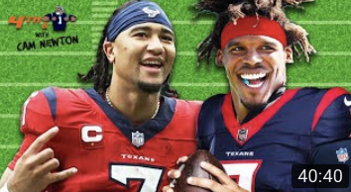

GAME!
Learnings
Extremely expressive faces
4.3%
Faces cover higher % of image
None of these faces were taken by us
7.9%

Slide 10
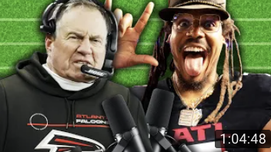

GAME!
Learnings
Extremely expressive faces
7%
Faces cover higher % of image
One of these was taken by us
No text
3.5%

Slide 11

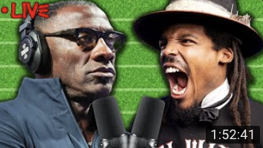
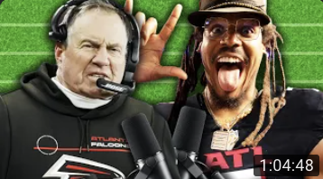
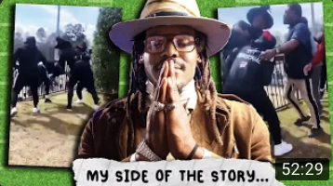



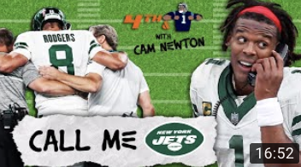

Hero Thumbnails CTR
Learnings
Creator hacking
Creator hacking
Creator hacking
Viral Moment
This strategy is how we get more views
7.3
7.0
7.0
Creator hacking
Creator hacking
We only reacted to a shannon clip BUT it became a top thumb
Viral Moment
7.0
5.8
5.5
Who can we latch onto?
Creator hacking
Viral Moment
Creator hacking
Viral Moment
Creator hacking
Text on in 2/9... the power of faces
5.4
5.4
5.1

Slide 12

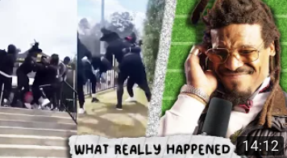




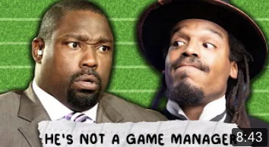


Thumbnails Views
Learnings
Creator hacking
Viral Moment
Creator hacking
Most thumbnails faces are from same shoot
11.4
11.4
11.1
Creator hacking
Creator hacking
Creator hacking
Clear face, well lit
We need to nail thumbnail faces
10.5
10.3
10.2
Guest thumbnail faces are equally important... we need to find a balance with guest
Creator hacking
Creator hacking
Creator hacking
9.5
9.5
9.4

Slide 13
Execute
Slightly changed 4th&1 format to UP subscribers
Make better Pre-Intros to UP AVD
Add more edit power for verticals to UP Growth
Take better thumbnail faces to UP Click Through
Make main show slightly longer to UP Revenue
Add more segments/reacts to post more clips to UP Revenue

Slide 14


Main
Editor
Brelan
New editor 1?
New editor?
Clips &
verticals
Brelan
New editor 1?

Slide 15
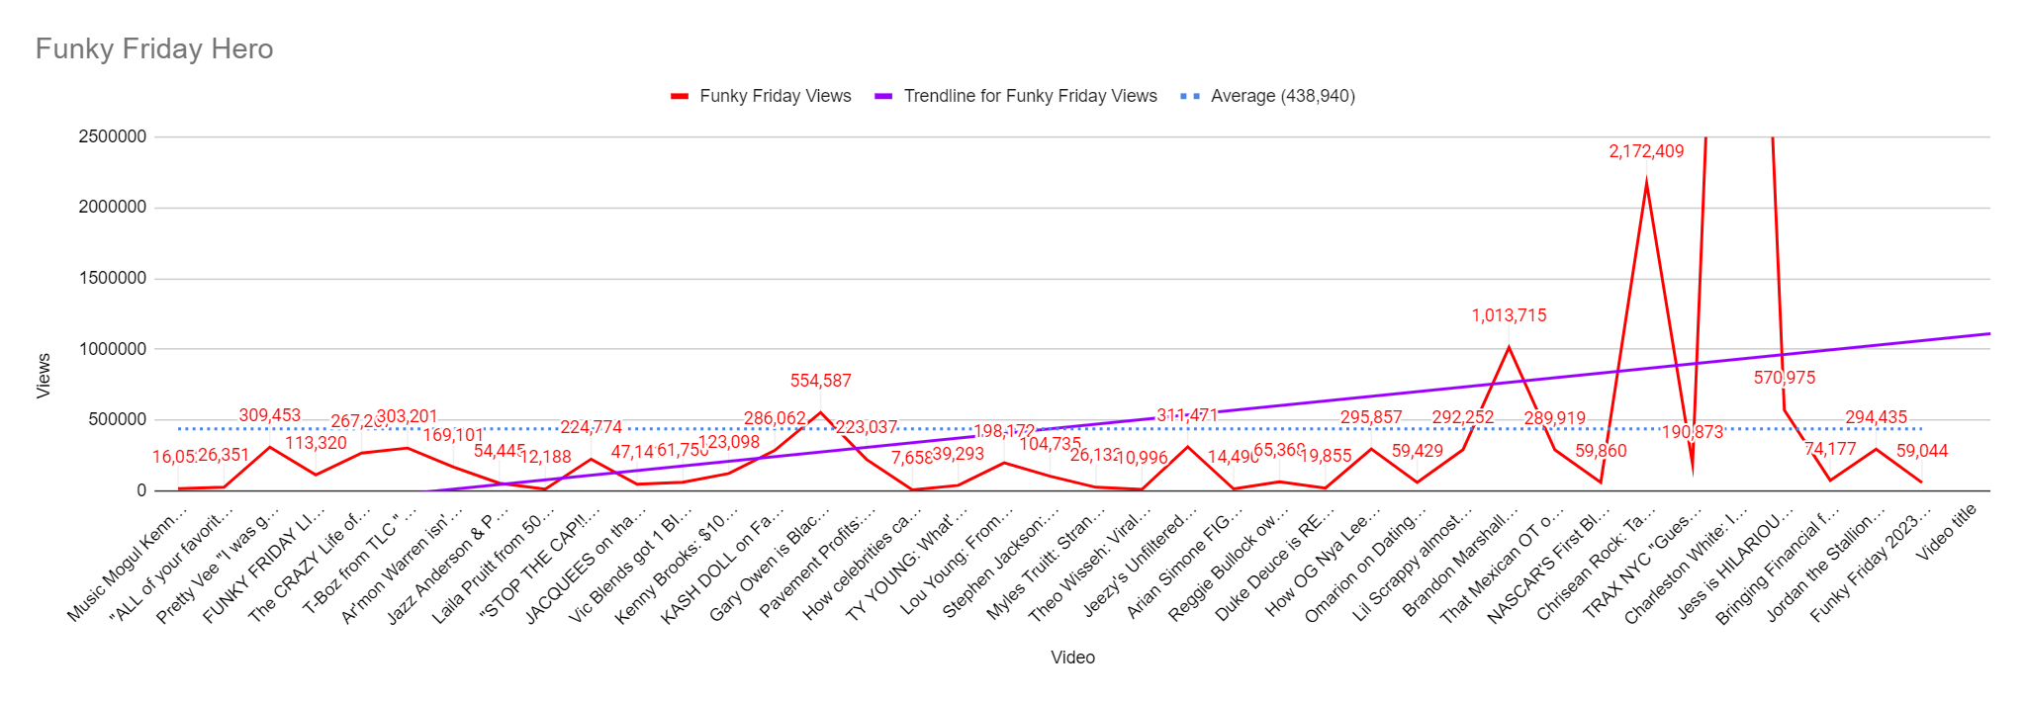

Slide 16
Learnings
Total Hero Views: 17,131,069
Total Clip Views: 1,325,717
Highest Hero Views: 8,163,397
Lowest Hero Views: 7,657
Average (Hero) CTR: 4.0%
Average (Clip) CTR: 6.7
AVD (Hero): 21.4% - 28:30
AVD (Clip): 34.4% - 3:16
AVD is great!
Hero thumbnails need to be better
Update old thumbnails
Less is more for the future

Slide 17
-Embrace strong intro leading to long form format AVD
-Enable vertical bois with more content growth
-Ask for subscribe ASAP growth
- Longer videost
1:00:00
2:00:00
1:00
:30-1
:5-:30
45
10
:5-:30
45
3
Pre-Intro
Cam opening
subscribe
Iconic Members
interview
Game
ads
Interview
Outro

Slide 18
Subscribers
Learnings
Main show
Let’s be more clever and have fun with it
Clips
Experiment with funny and lighthearted subscribe bumps
On set
We want more plaques

Slide 19
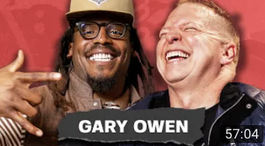

GAME
Learnings
Gary Owen
557,303
Jess Hilarious
571,715
Longer = revenue
Longer = more clips
GAME - how much MORE did Jess HIlarious make?
$7,216.67

Slide 20
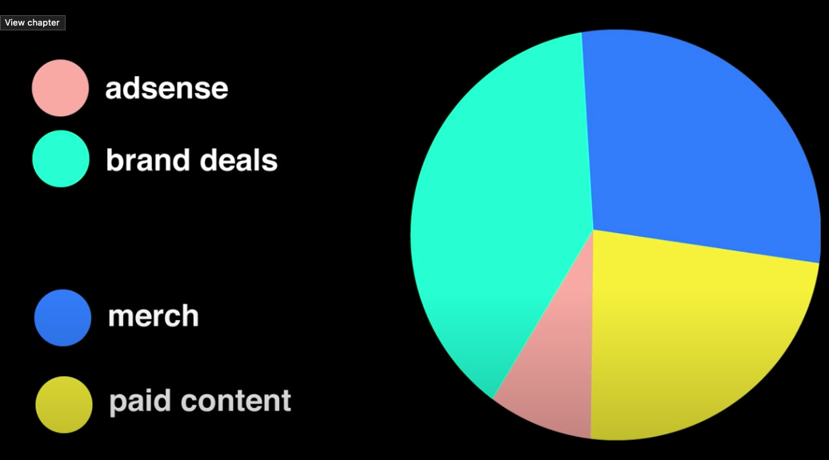

Slide 21


GAME Thumbnails
Learnings
No wasted space
Before change thumbnail average was 3.20%
After change thumbnail average was 3.33%
4.9
3.8
Consider this is resting CTR. Early video spike was dramatic
CW - 102,441,187
PV - 4,449,354

Slide 22
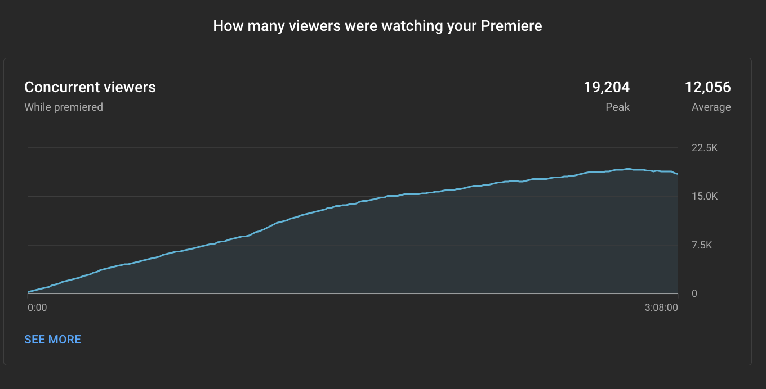
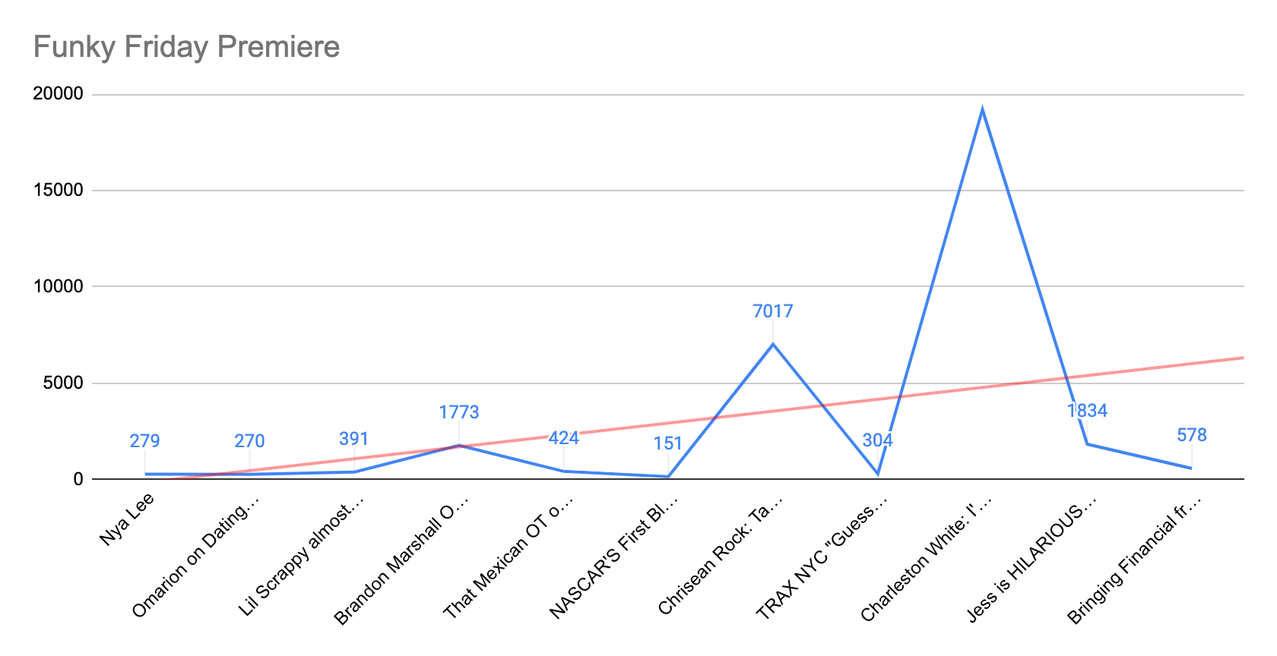
Premiere
Learnings
We started Premieres to interact LIVE with the audience
When we premiere we LOCK our video to the top left of viewers YouTube homepage
We saw an uptick in performance of each video

Slide 23
GAME
Learnings
Top 5 clips
Alycia Baumgardner - 374,023
TI - 220,763
Vic Blends - 183,195
Gary Owen - 97,527
Pivot - 65,721
Clips don't care how big the hero was
Extra opportunities to title and thumbnail is the reason we clip
Good clips revenue too!

Slide 24
Execute
Slightly changed funky friday format to UP subscribers
Make better Pre-Intros to UP AVD
Add more edit power for verticals to UP Growth
Make main show as long as possible to UP Revenue
Balance “demonetized” videos... they grow us A LOT but make less $

Slide 25
Audio
Learnings
Shoutout audio in intro
We ask for subscribe on yt
Audio only segment?
Different welcome intro
Audio only fan question
CTA
We ask for a follow & RATE the show on audio
Social post
Pop audio icons up
Vertical of the AUDIO only question
Waveform post?
Exclusive episode? (for members too)
Cam & O breakdown show
Opposite fridays
We need to do something
We may need to add a few talking bits to ROS so audio fits better
It really comes down to how big a priority this is...

Slide 26
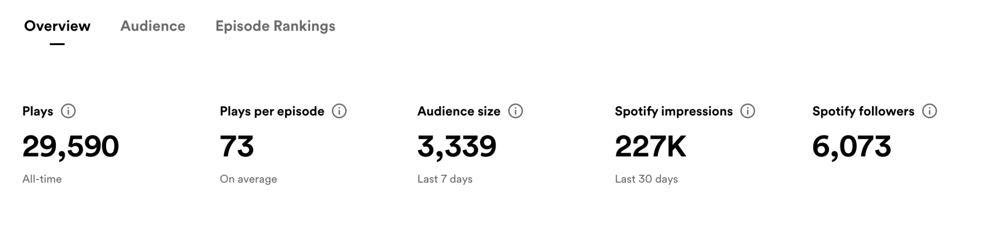
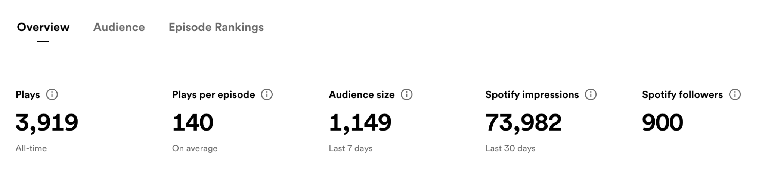
GAME
Learnings
GAME - which analytics goes with which show?
These shows have a small amount of natural growth
But they need love

Slide 27
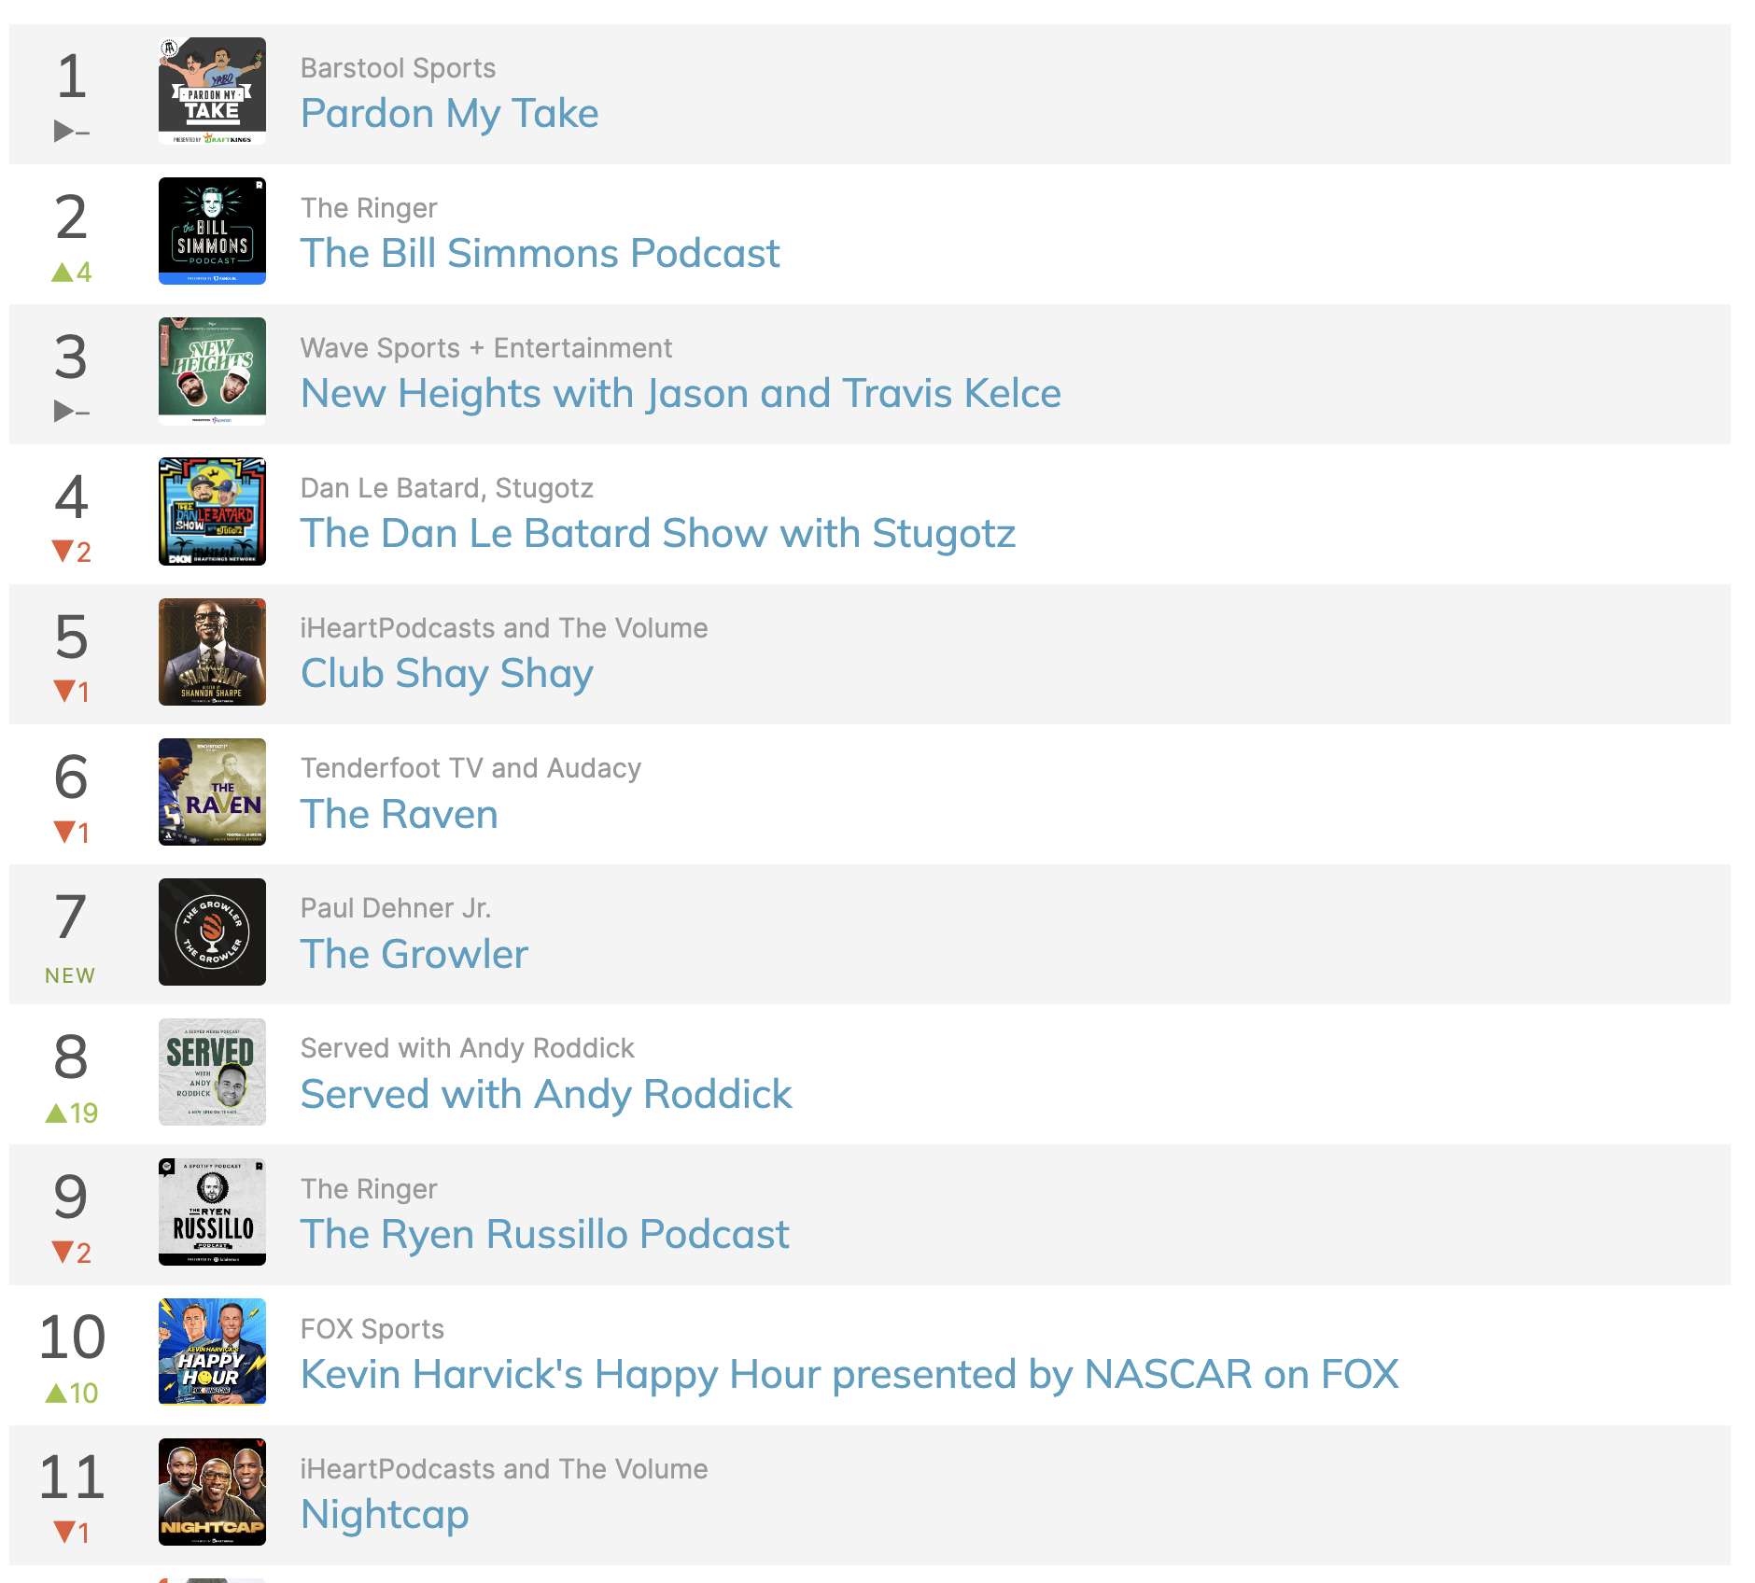
Learnings
I can see us on this list
We just need to pick a direction and GO

Slide 28
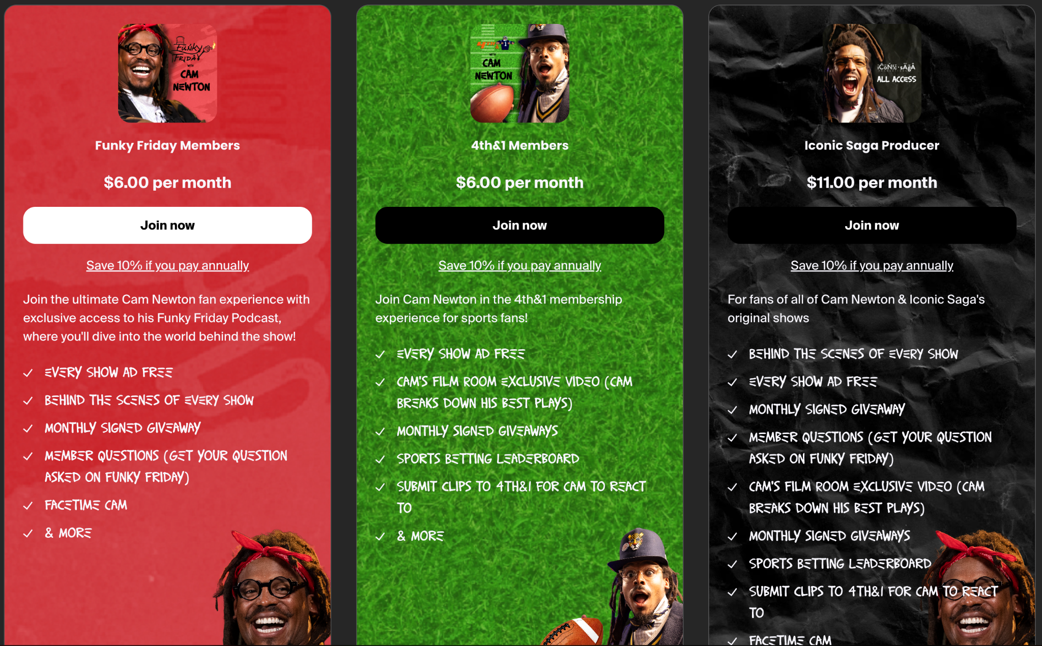
MEMBERS
Likely will be TOP
https://cam-newton-shop.fourthwall.com/

Slide 29
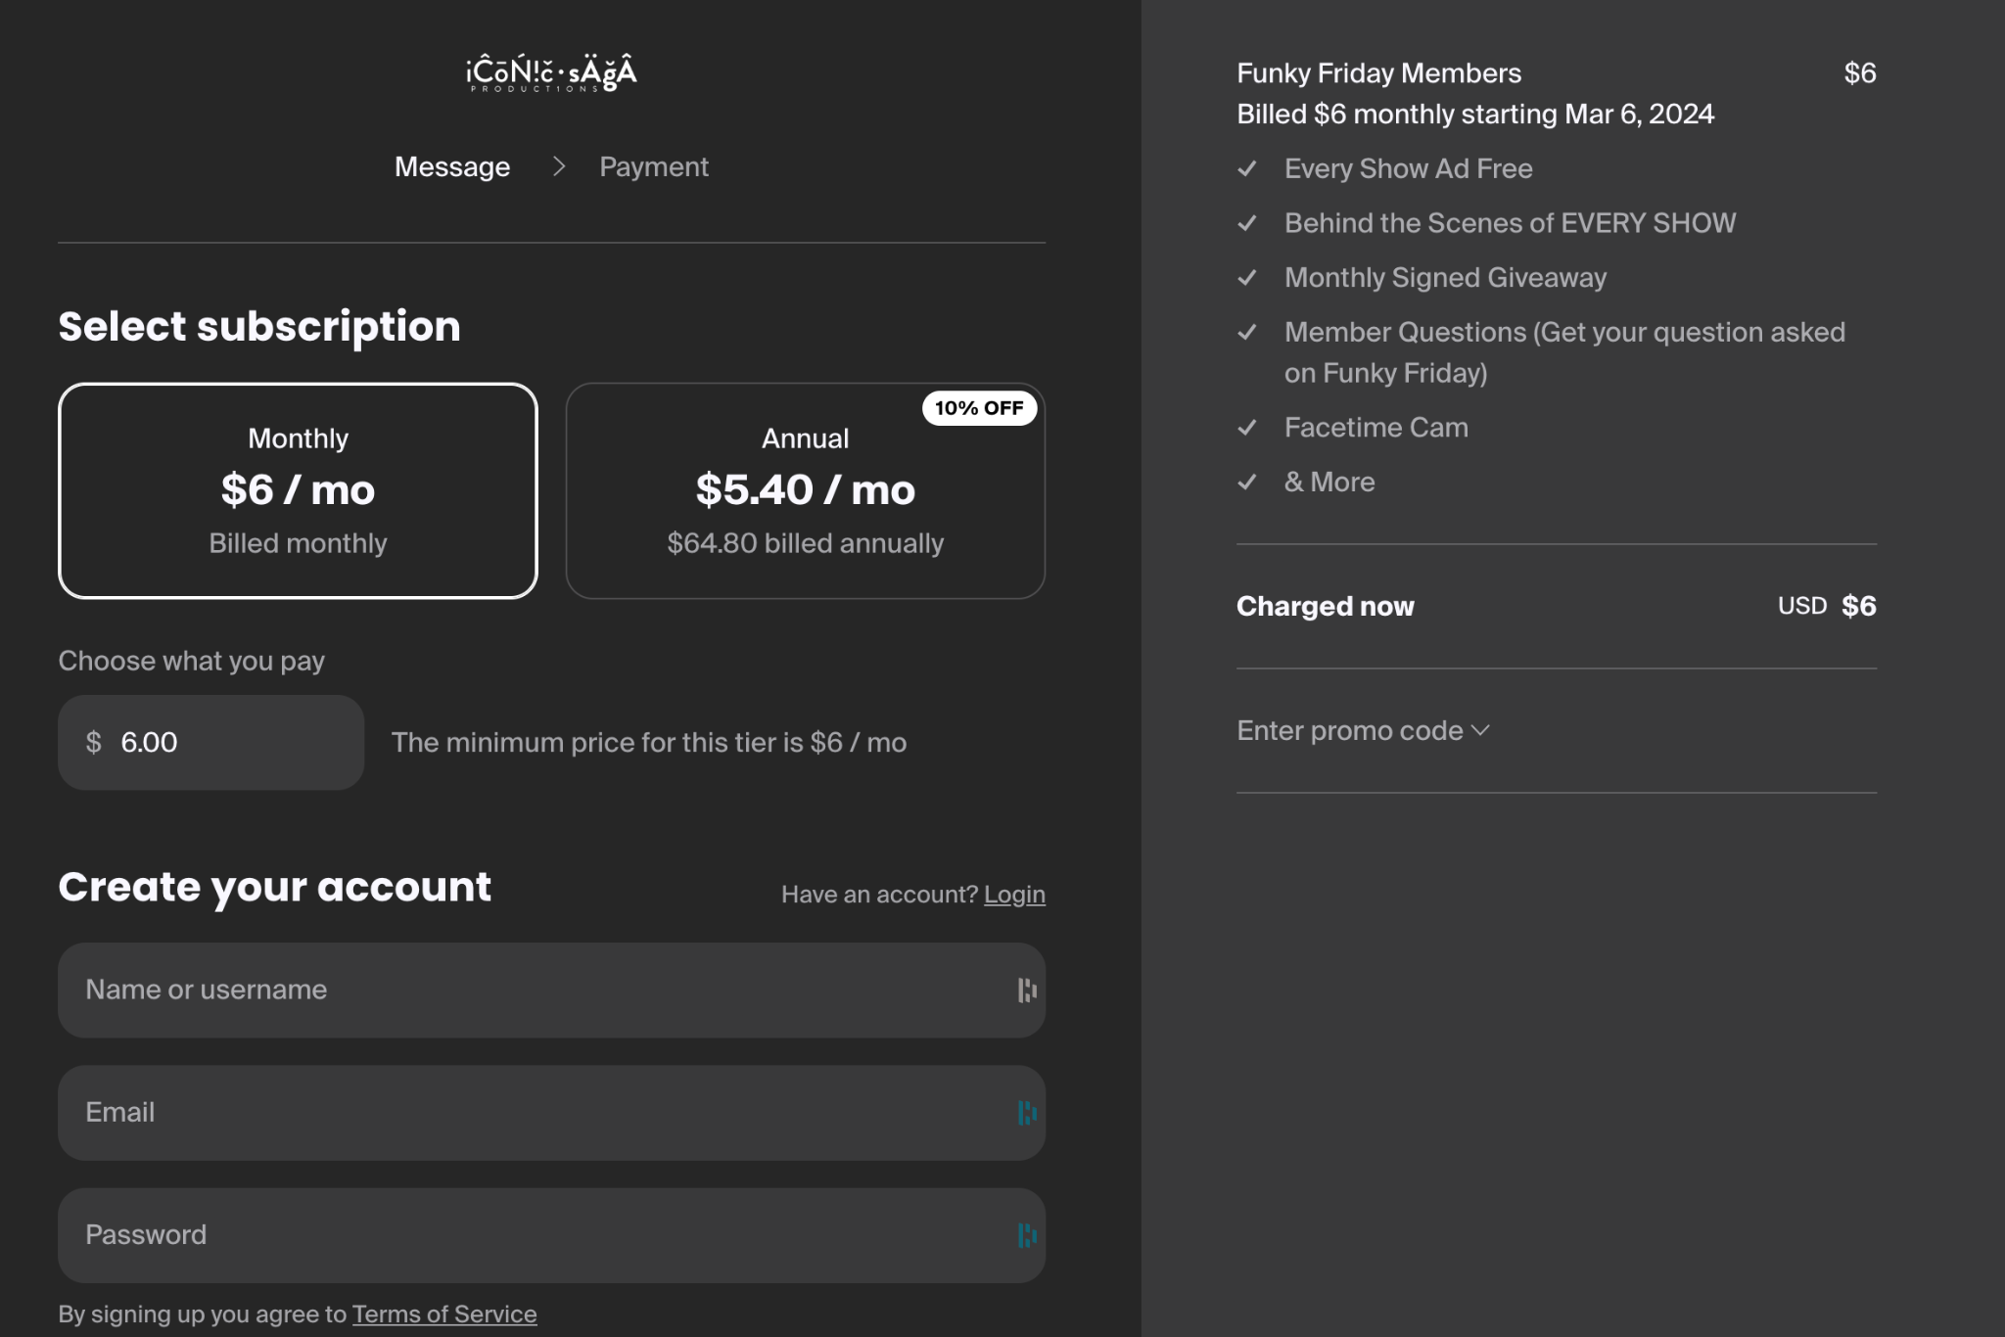
Instant checkout

Slide 30
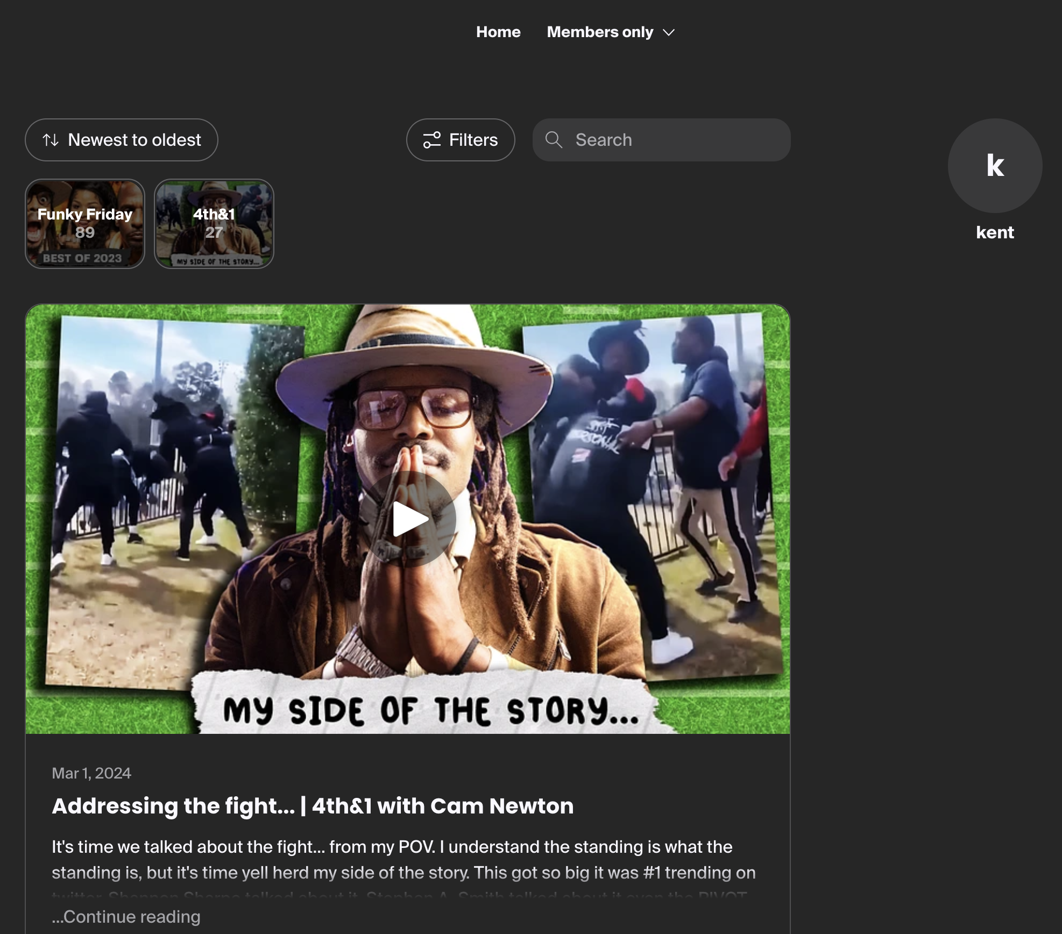
https://cam-newton-shop.fourthwall.com/supporters

Slide 31
Promotion
A video for each offering
5-15 seconds on every video
Ad free
FF BTS we edit a cutdown of the BTS
Polaroid, we film a promo of taking a few polaroids
Member questions - show the comments section then cut to cam asking the question
Cams film room cutdown
Submit clips post into cam reacting to top clip
Popup icons in all videos

Slide 32
11
10 Polaroid
Submit clips
10 Polaroid
BTS
Submit clips
Member Q
Cam’s film room
Submit clips
Facetime
BTS
Submit clips
Member Q

Slide 33
Merch
Learnings
We can upload designs and print
We can connect other stores
C1N
Meshika
We can plug into youtube merch Shelf
Directly under all our video’s our merch will be listed
We can do collections
Changing things out and cycling designs offers us more opportunity to see
Follow the DATA
Merch can be up to 25% of our business
Being nimble to change and update
Sit with our analytics improve

Slide 34
Email list
Learnings
Learnings
All members join a list
Every new post in group emails
We can extend group to all viewers
List can be easily exported
I can see us on this list
We just need to pick a direction and GO
Direct line to followers
Have bigger launches of new projects
Build community
Promote members

Slide 35
Analytics
Learnings
Financial
Total Members
Member change
Total orders
Average order value
Top products
Top tiers
Locations
GOOGLE ANALYTICS
Set Up monthly analysis meetings to continue growth
Evolve offerings as we go

